Slide 1
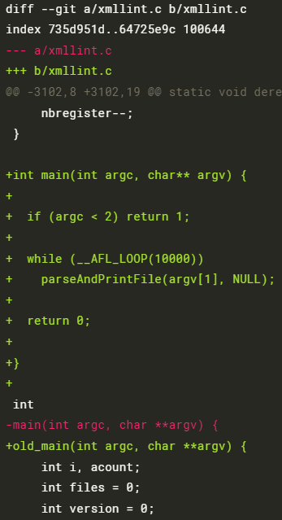
AFL++ Tutorial with libxml2
Fuzzing the program xmllint from libxml2 using AFL++ llvm mode
with two sanitizers Address Sanitizer (ASan) and Undefined Behavior Sanitizer (UBSan)
with 38 seed inputs from the libxml2 project
Normal mode vs. Persistent mode
Normal mode: simply compile the xmllint program using afl-clang-fast (the llvm mode compiler)
Persistent mode: modify the xmllint program for persistent mode and compile using afl-clang-fast
The loop for persistent mode invoking the parseAndPrintFile function

Slide 2
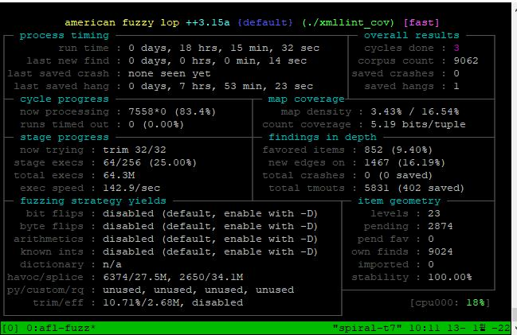
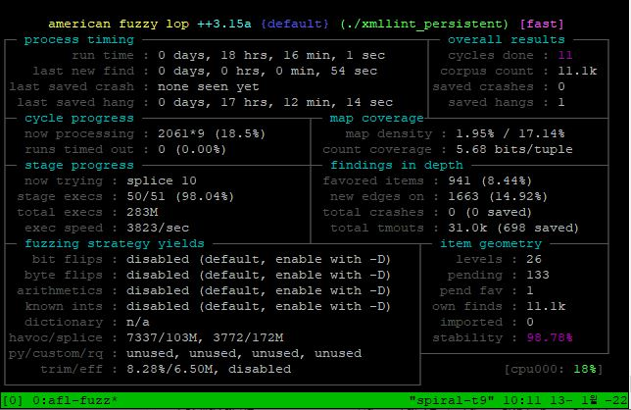
Result: AFL++ Tutorial with libxml2
Normal mode
Persistent mode
Significantly increased number of executed inputs due to the persistent mode
Less than 100% of stability, but still very high (may be stateless)
However, why does the loop contains only the parseAndPrintFile function and not the main function?

Slide 3
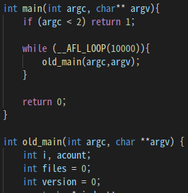
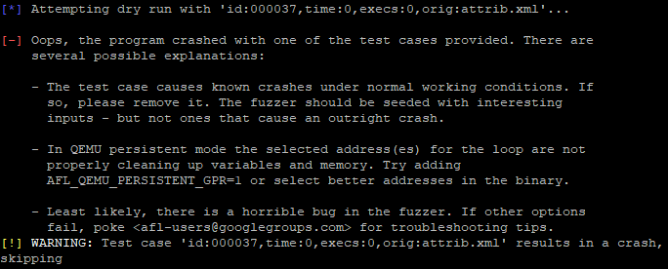
Fuzzing xmllint on the Persistent Mode
Fuzzing xmllint not the parseAndPrintFile function
wrapping main function by the loop for persistent mode
Result: fails due to crash for all seed inputs
which induces terminating fuzzing
while the compiled program itself works successfully with the seed inputs
A seed input

Slide 4
Fuzzing xmllint on the Persistent Mode
Does the input buffer access (i.e., access to argv) induces crash on the persistent mode?

Slide 5
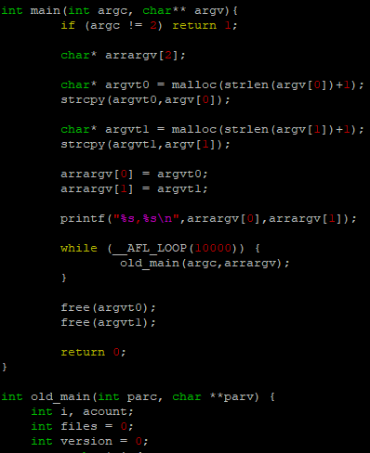
Fuzzing xmllint on the Persistent Mode
Copy the input to another location other than argv and feed to the old_main function
Result:
The compiled program itself works successfully for seed inputs.
However, fuzzing still fails due to crashes for seed inputs.

Slide 6
Dry-run in AFL++
Execute each seed input eight times for calibration
In normal mode (one input per one process),
No difference between the eight runs with the same input (100% stability) if the target program is deterministic
In persistent mode,
Difference between the eight runs if there are states shared across inputs (<100% stability) although the target program is deterministic

Slide 7

Crash induced by Persistent Mode
Initialization
Global variables
(function pointer)
defaultEntityLoader = NULL
xmlCurrentExternalEntityLoader = xmlDefaultExternalEntityLoader
DR1
defaultEntityLoader = xmlDefaultExternalEntityLoader
xmlCurrentExternalEntityLoader = xmllintExternalEntityLoader
Should re-initialize
DR2
Stack-overflow!
defaultEntityLoader = xmllintExternalEntityLoader
xmlCurrentExternalEntityLoader = xmllintExternalEntityLoader
…
…

Slide 8
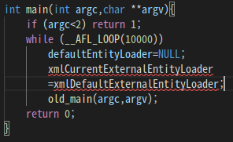

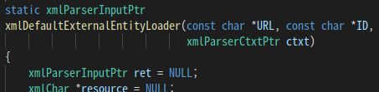

Issue on Re-initializing States
Restricted accessibility for static global variables
xmllint.c
xmlIO.c
Not visible
Solution1: initialization function on xmlIO.c

Slide 9
Issue on Re-initializing States
Restricted accessibility for static global variables
xmllint.c
xmlIO.c
Not visible
Solution2: remove static keywords?
Solution3: instrumentation at llvm IR or
binary level?

Slide 10
Result: In-Process (Persistent Mode) Fuzzing libxml2
Taking XML files, 38 seed inputs, 50461 edges, 3 hours (4 times)
With initialization function in xmlIO.c
 | exec/sec | edge_cvg | stability
Normal mode | 1055.43 | 20.13% | 100.00%
Persistent mode | 4720.79 | 21.40% | 99.74%
Re-initialize two global variables at the start of each input

Slide 11
Result: In-Process Fuzzing bloaty
Taking binaries, 101 seed inputs, 89530 edges, 3 hours (4 times)
No re-initialization
 | exec/sec | edge_cvg | stability
Normal mode | 2297.94 | 10.12% | 100.00%
Persistent mode | 5455.27 | 10.58% | 99.97%

Slide 12
Result: In-Process Fuzzing zlib
Taking zlib compressed (.gz), one seed input, 875 edges, 3 hours (4 times)
No re-initialization
 | exec/sec | edge_cvg | stability
Normal mode | 3801.90 | 72.71% | 100.00%
Persistent mode | 3402.84 | 74.20% | 65.96%
Libfuzzer style | 2322.01 | 73.37% | 100.00%
AFL++ with the driver for libfuzzer style fuzz harness LLVMFuzzerTestOneInput
(in-process fuzzing)
No dry-run

